Slide 1
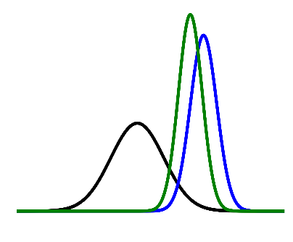
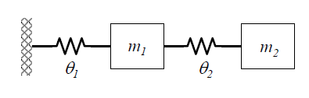
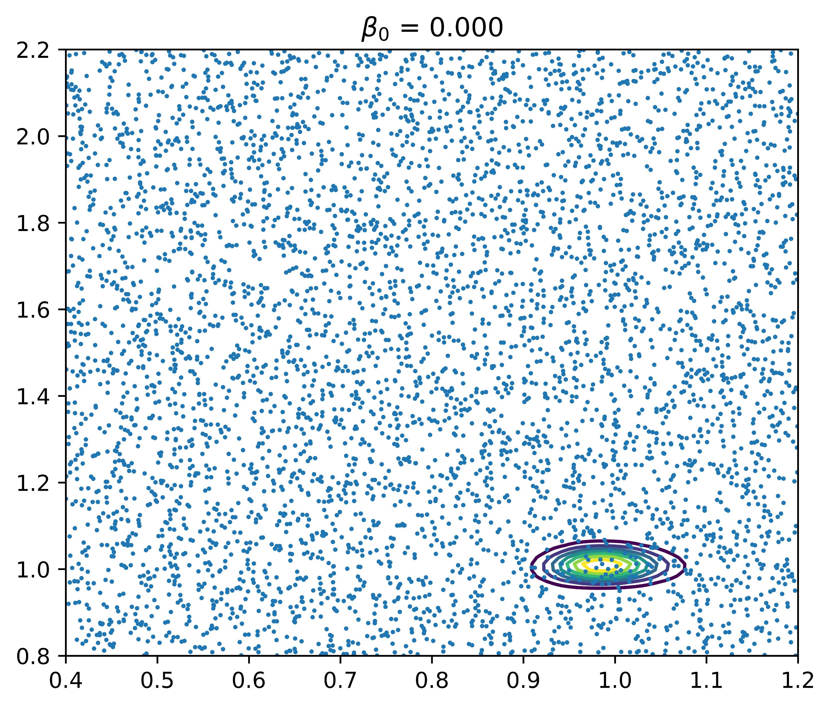
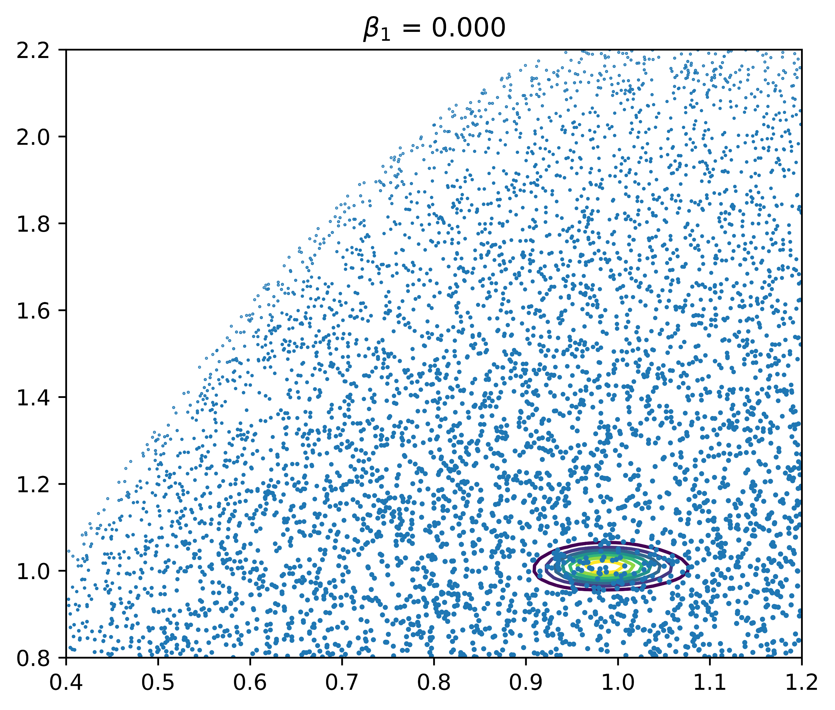
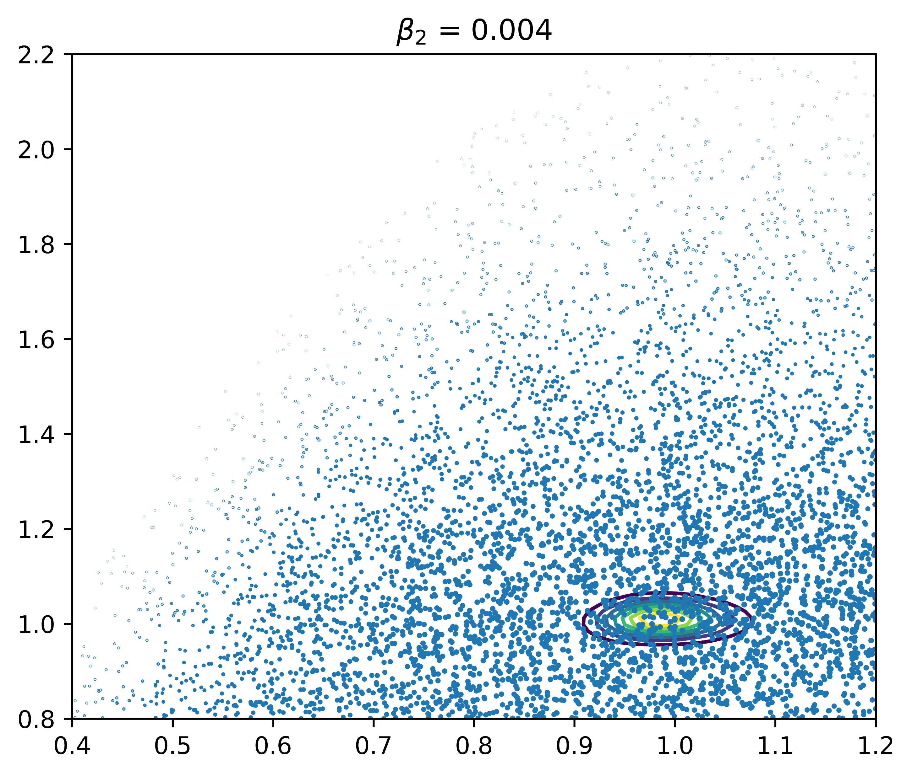
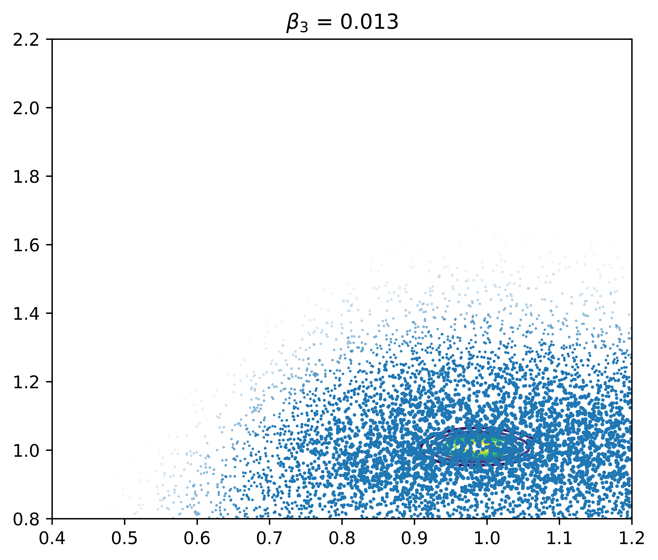
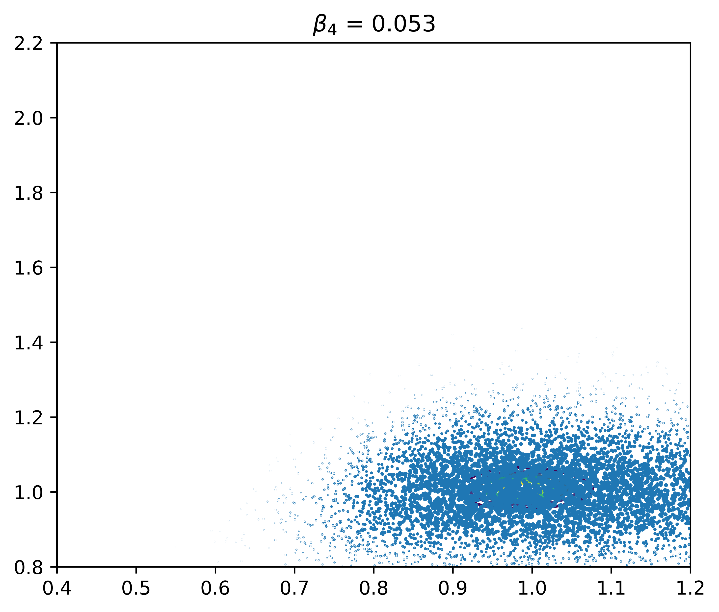
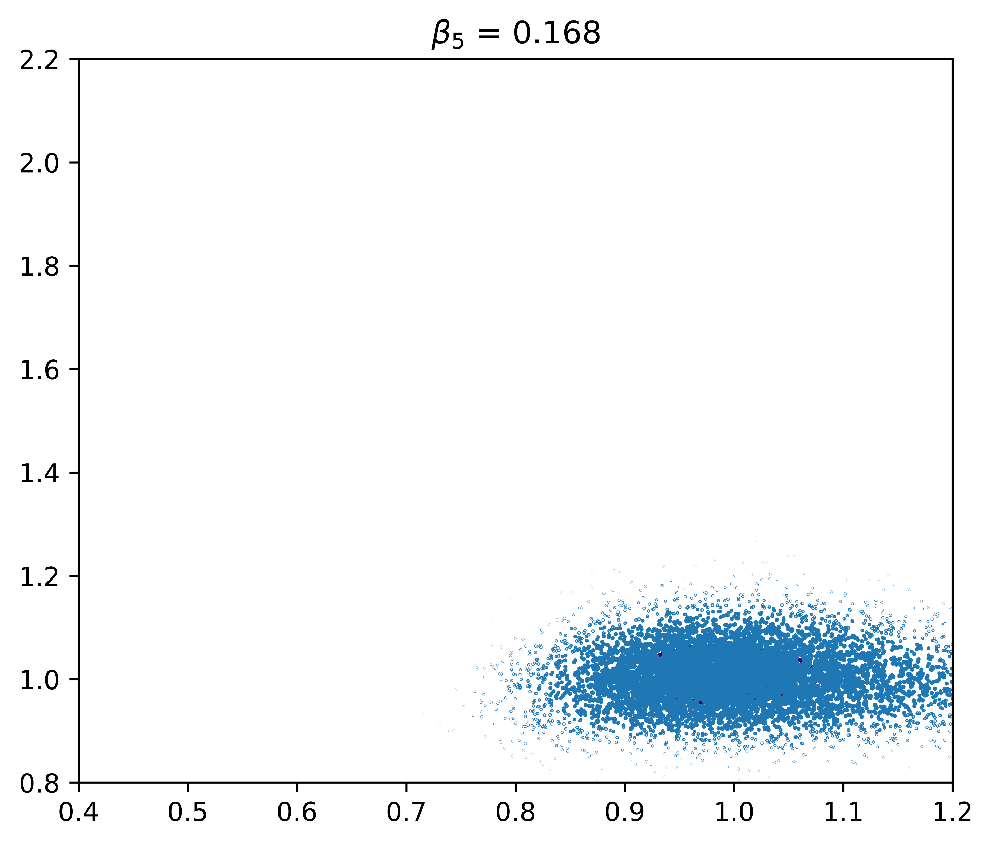
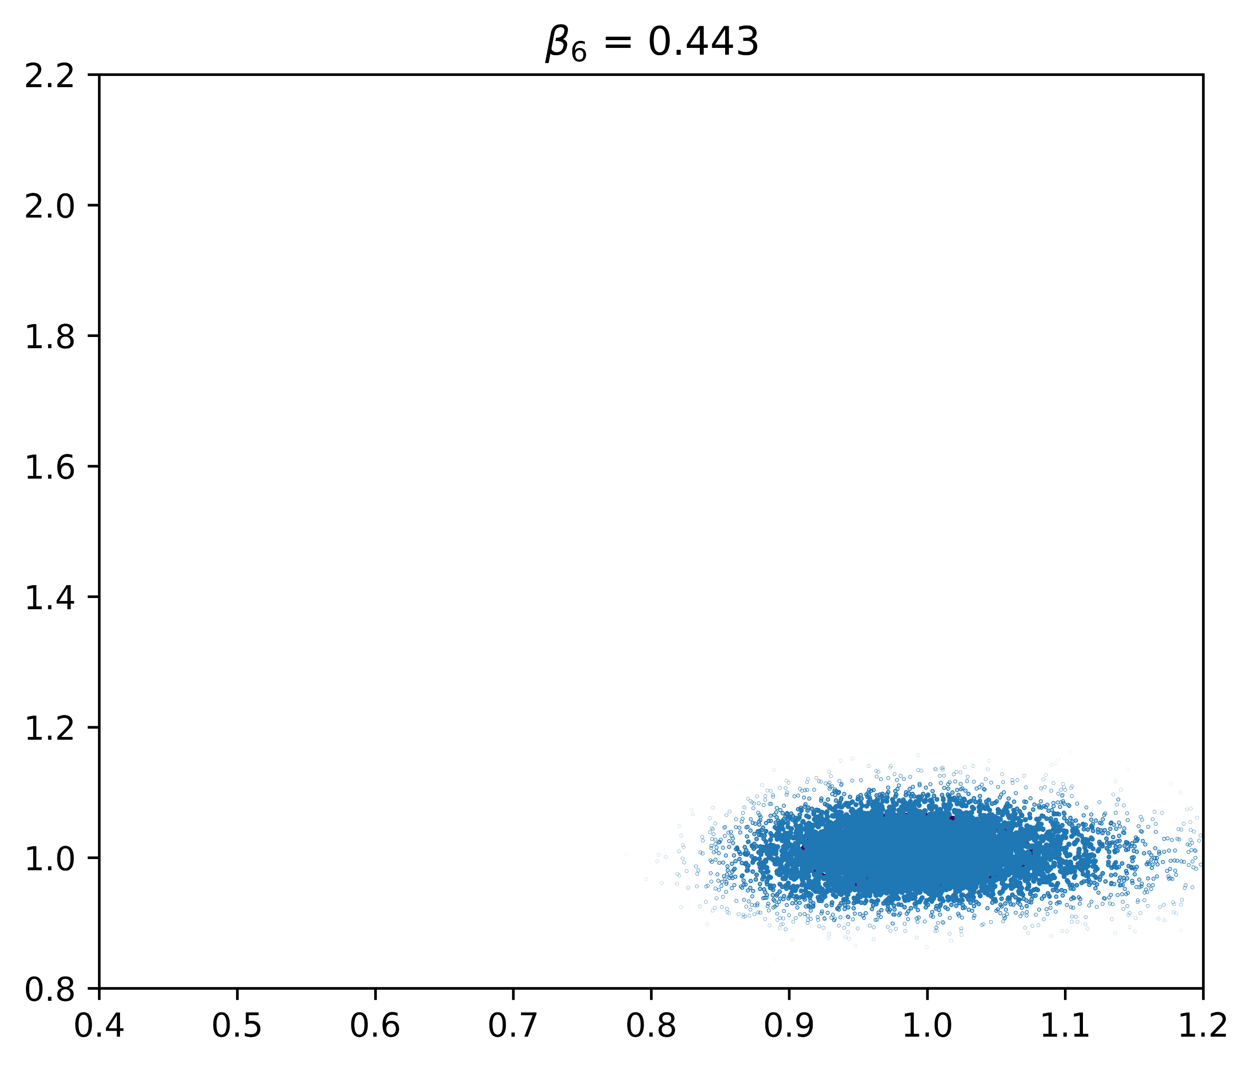

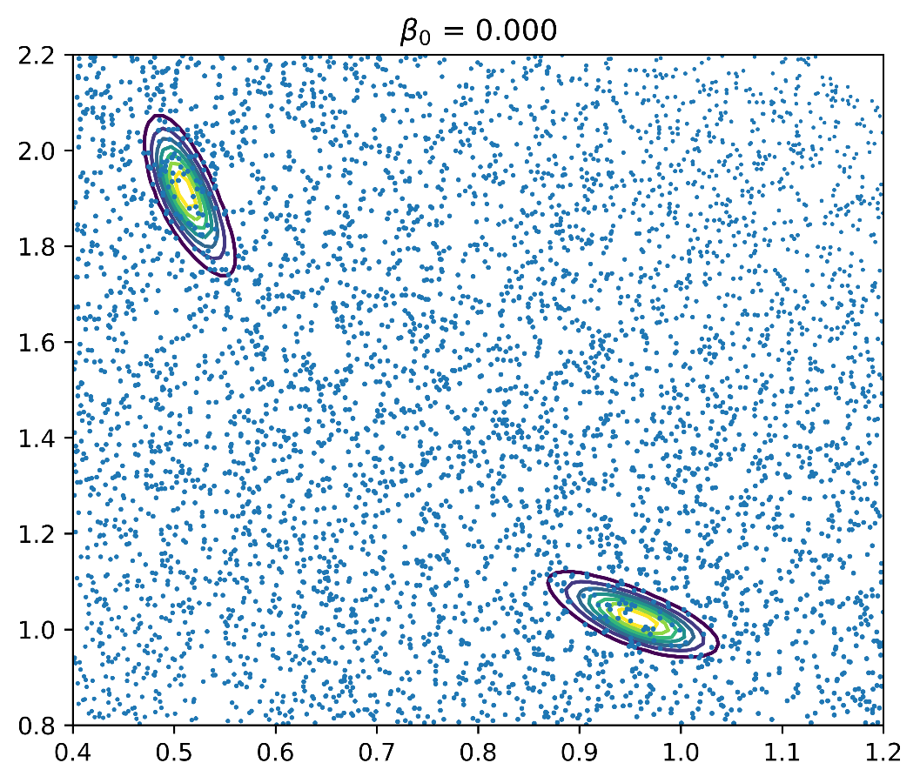
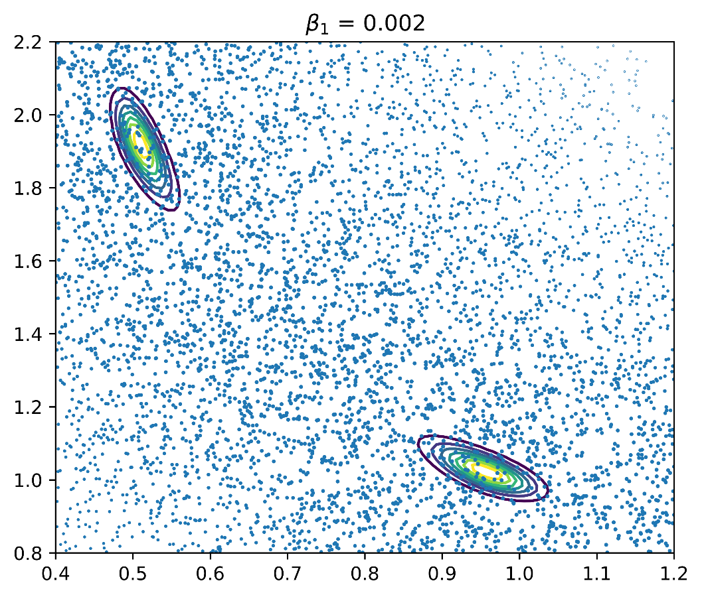
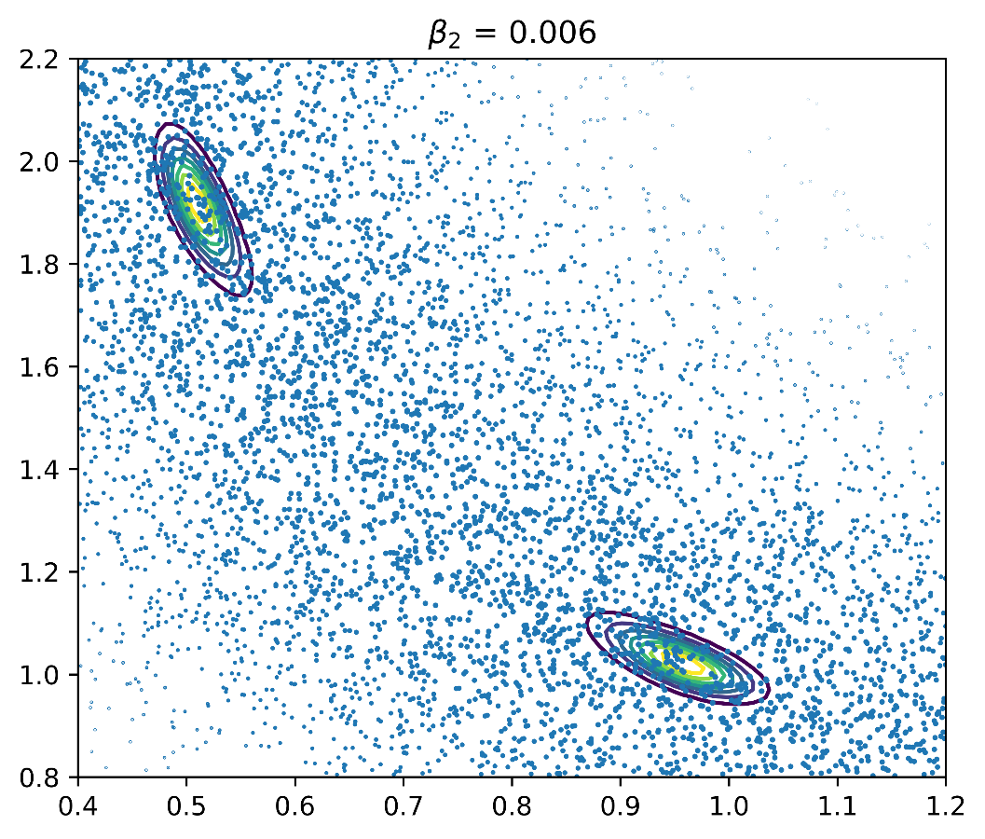
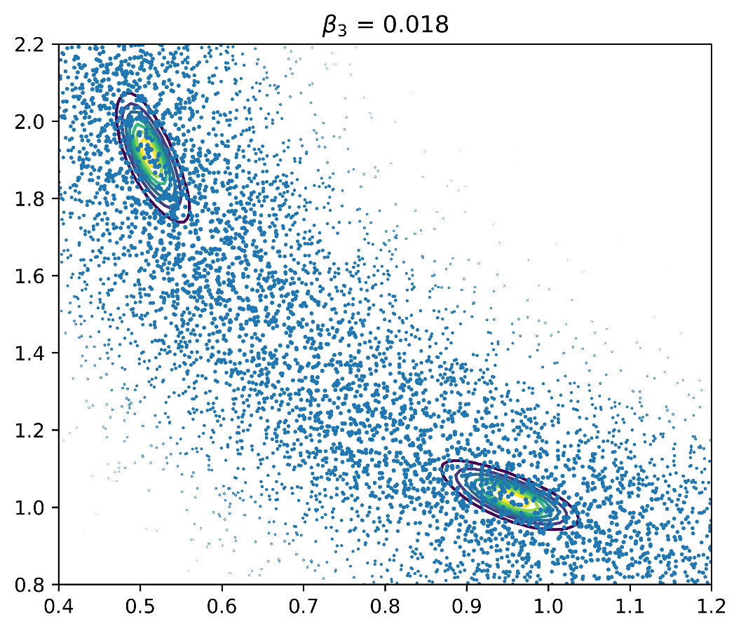
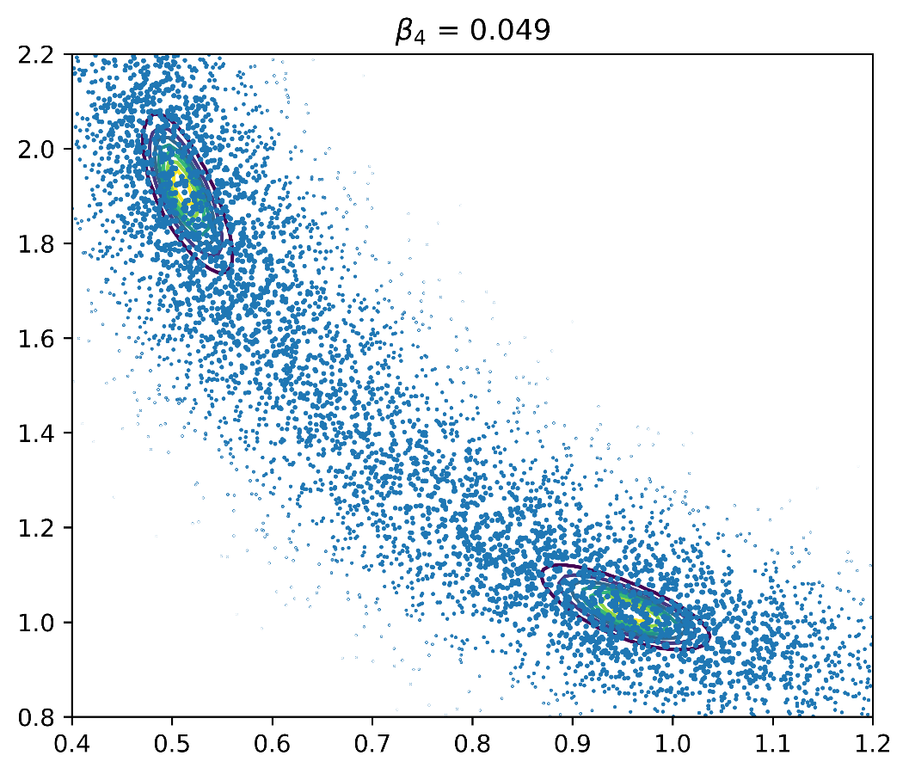
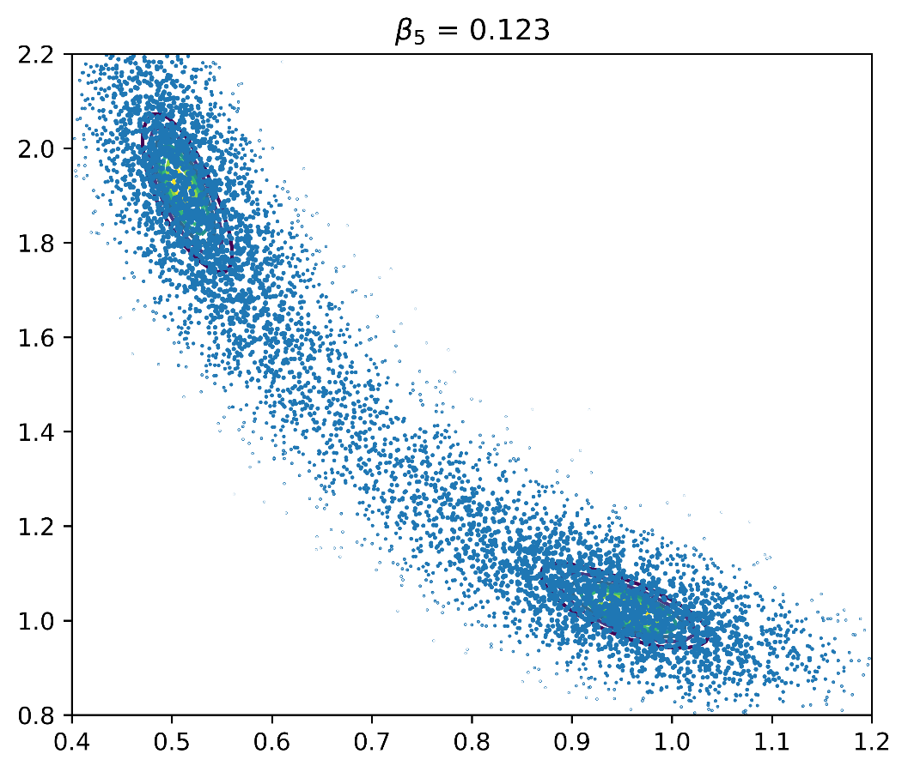
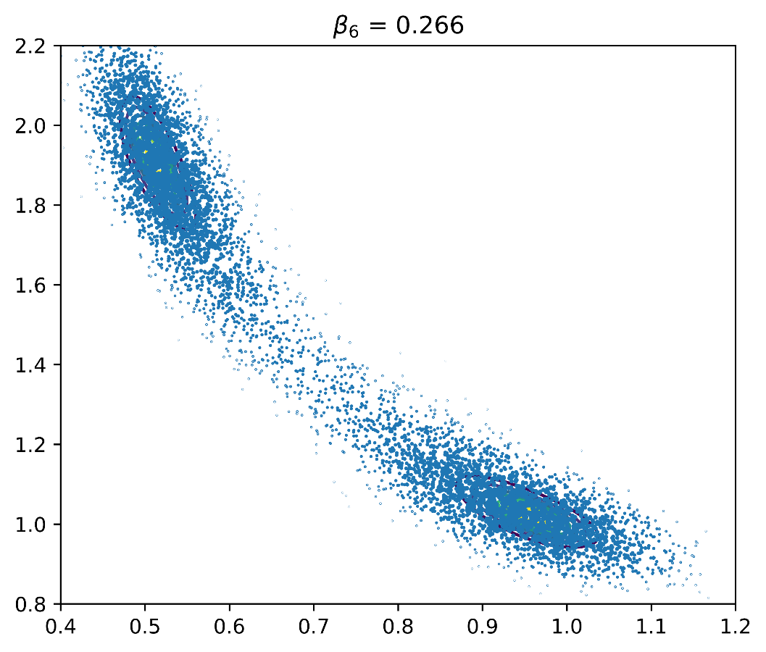
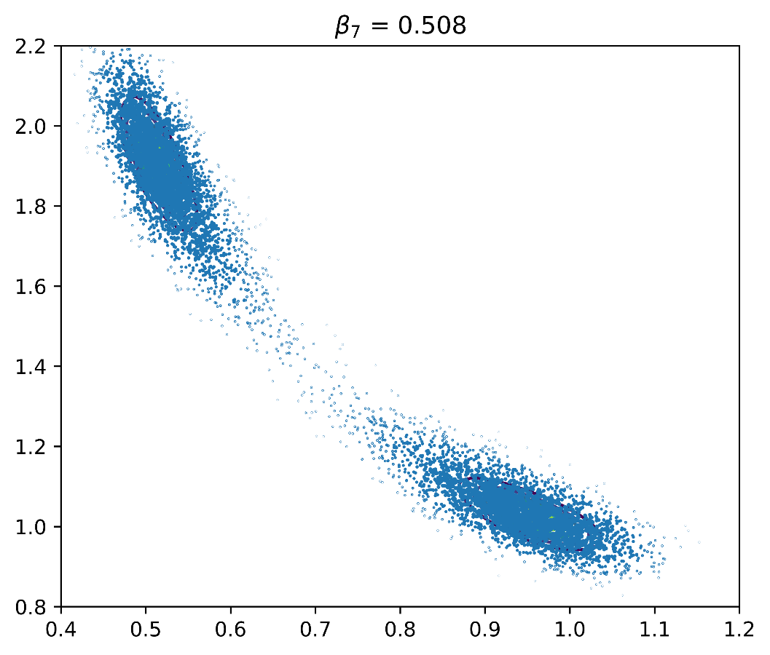

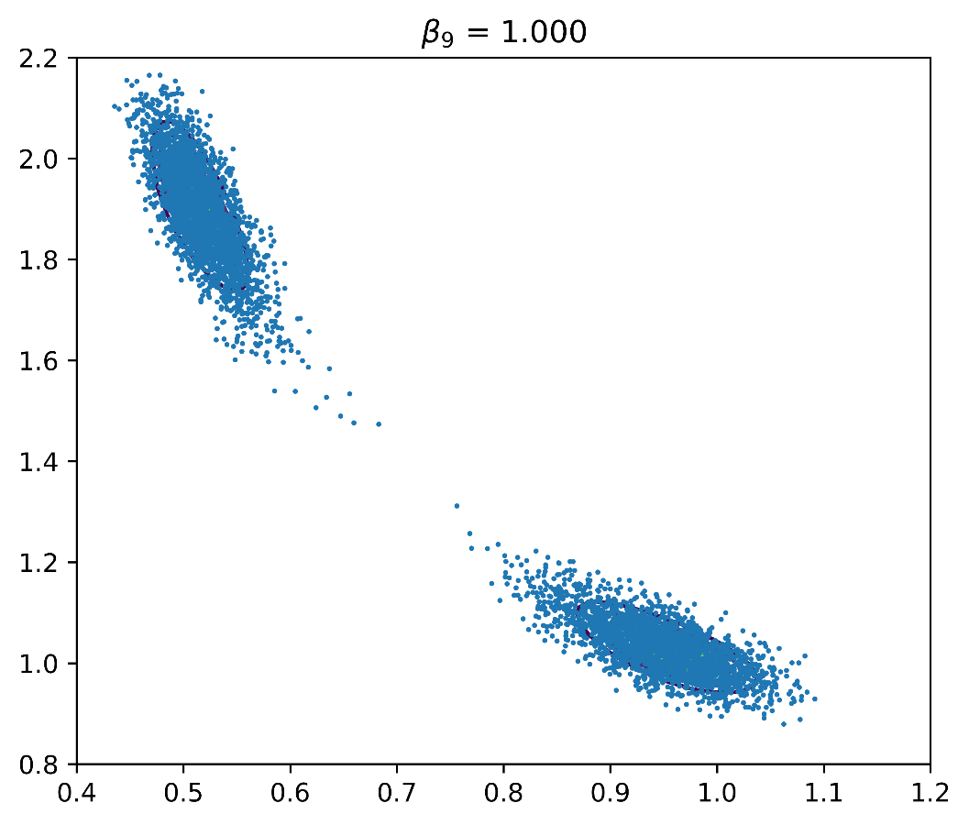
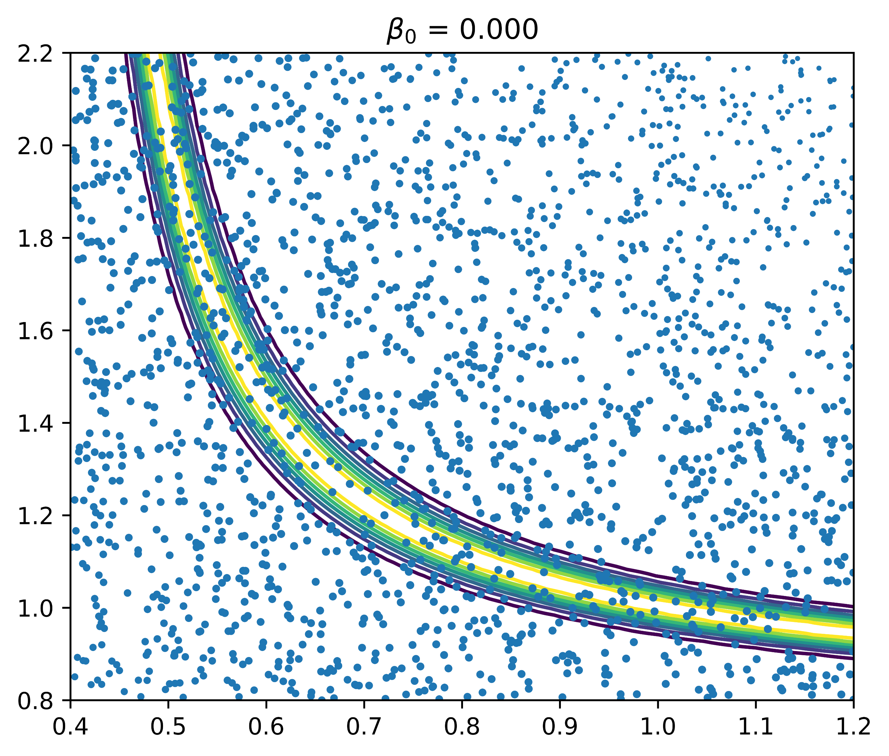
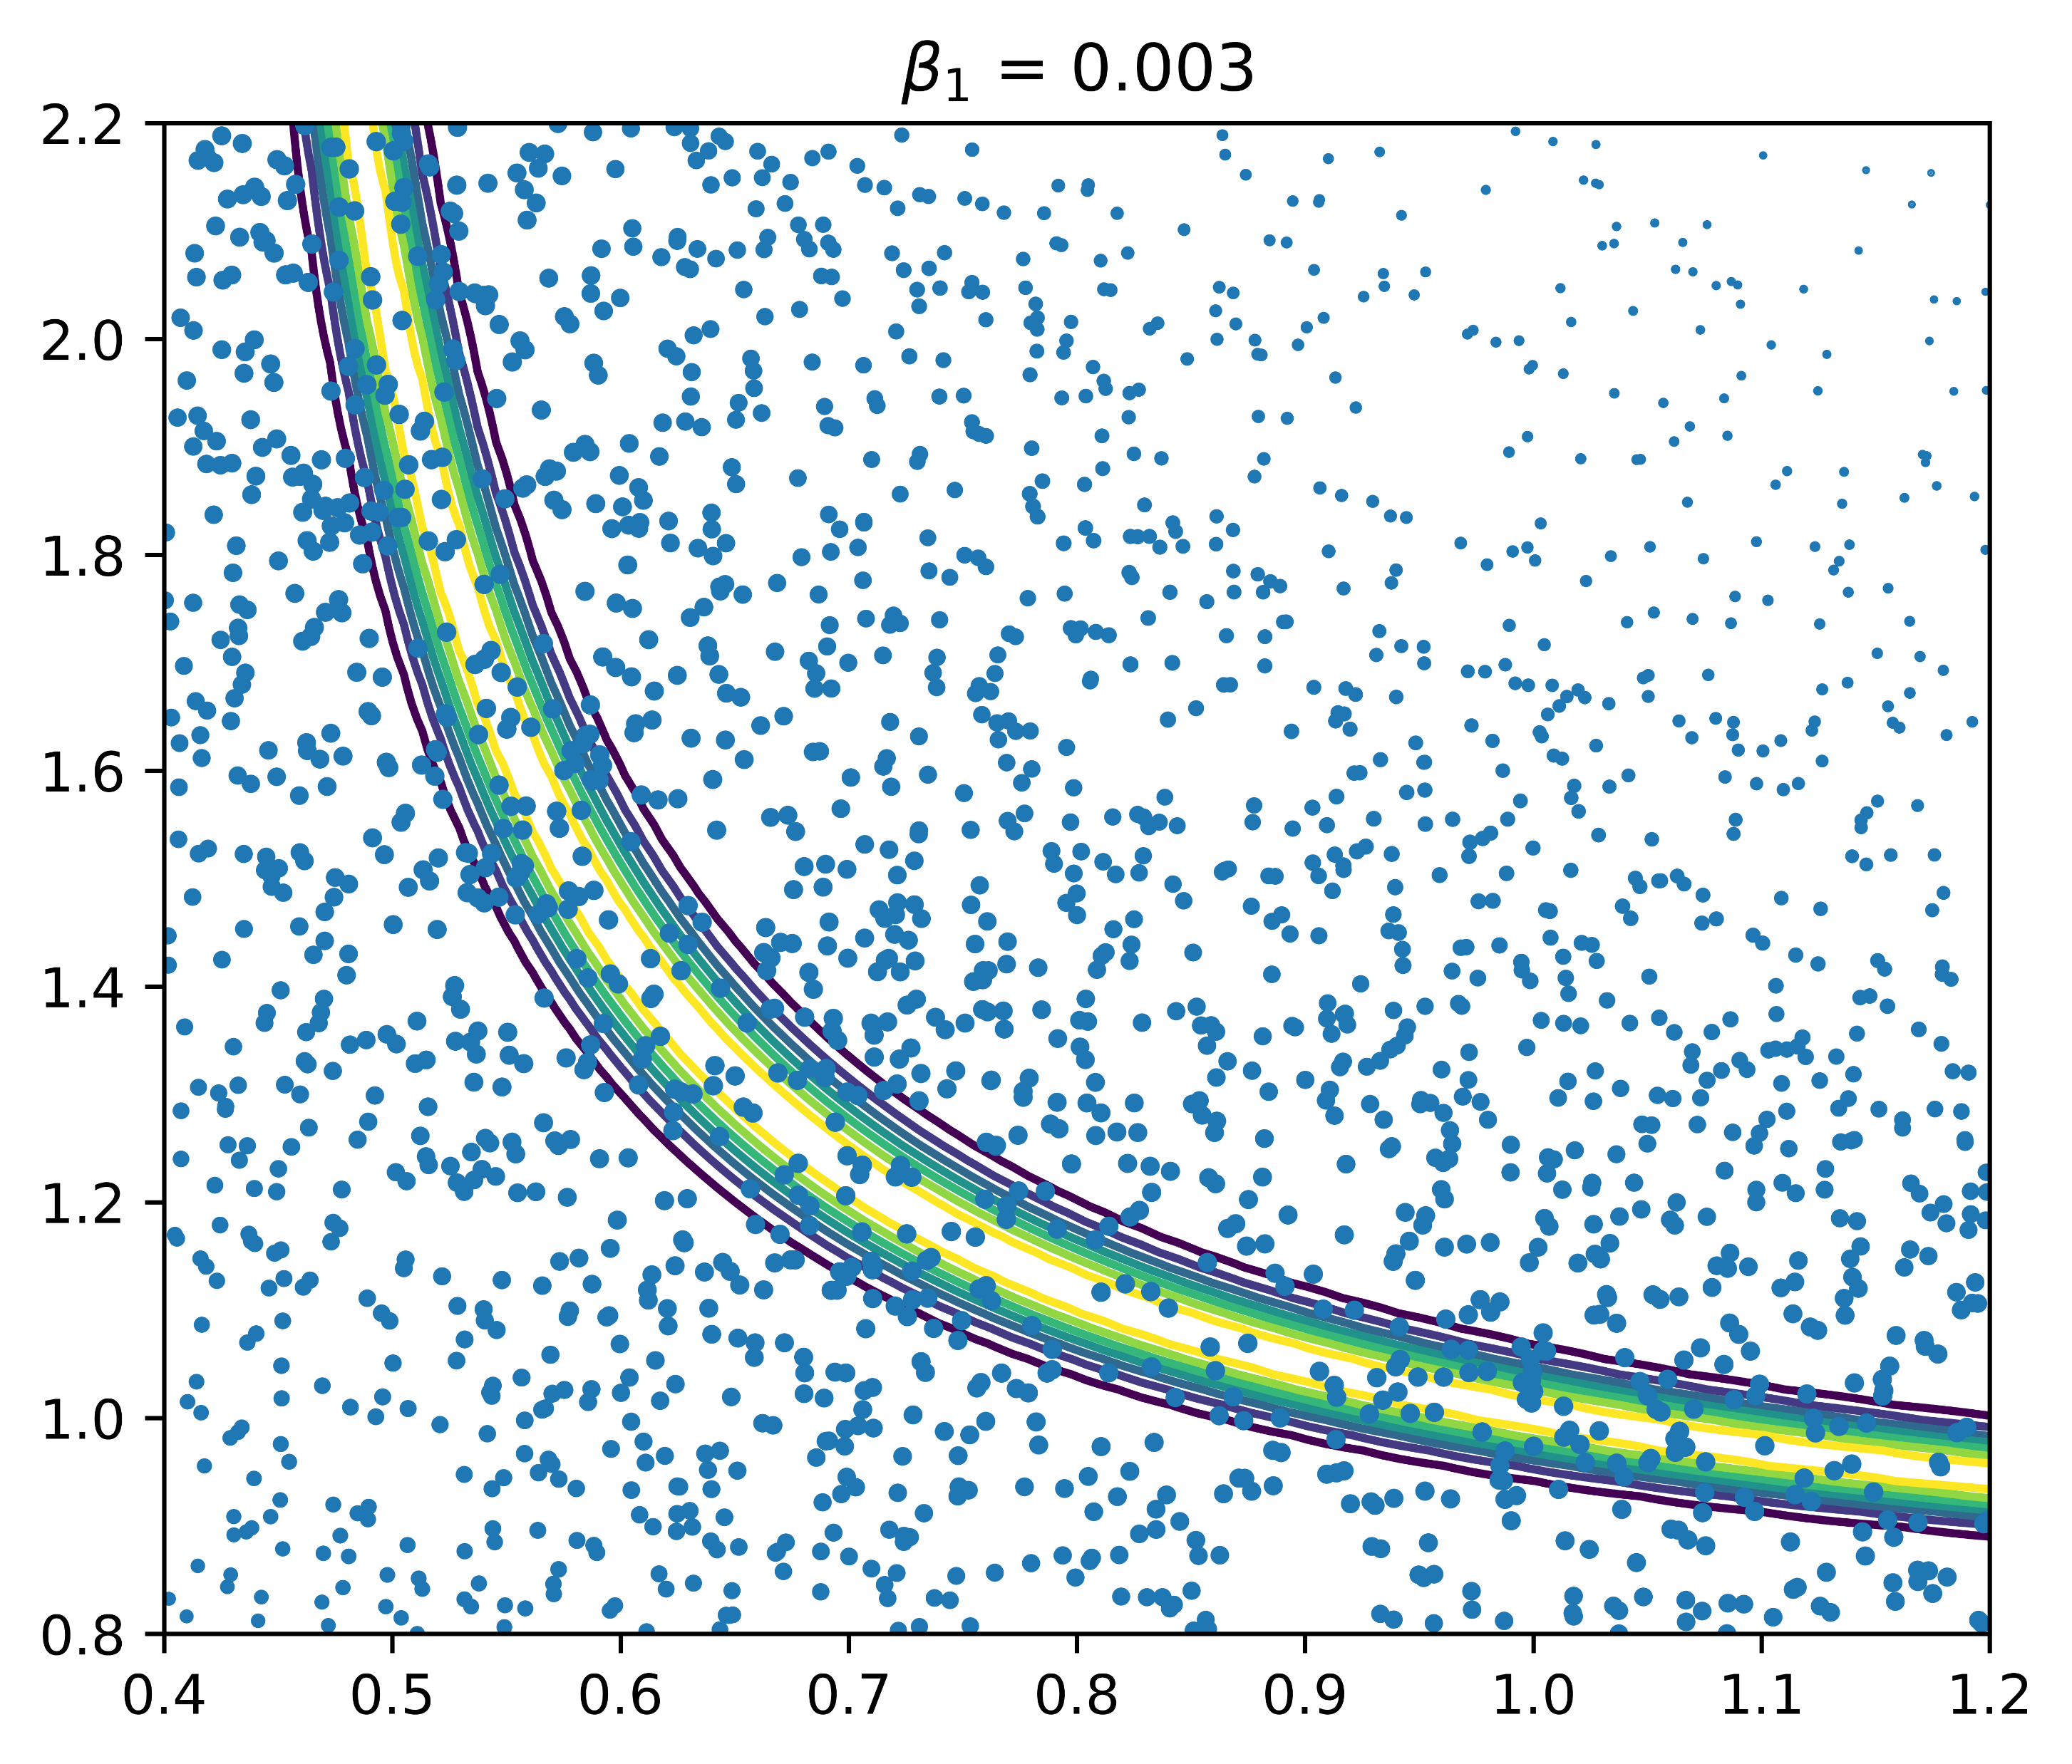
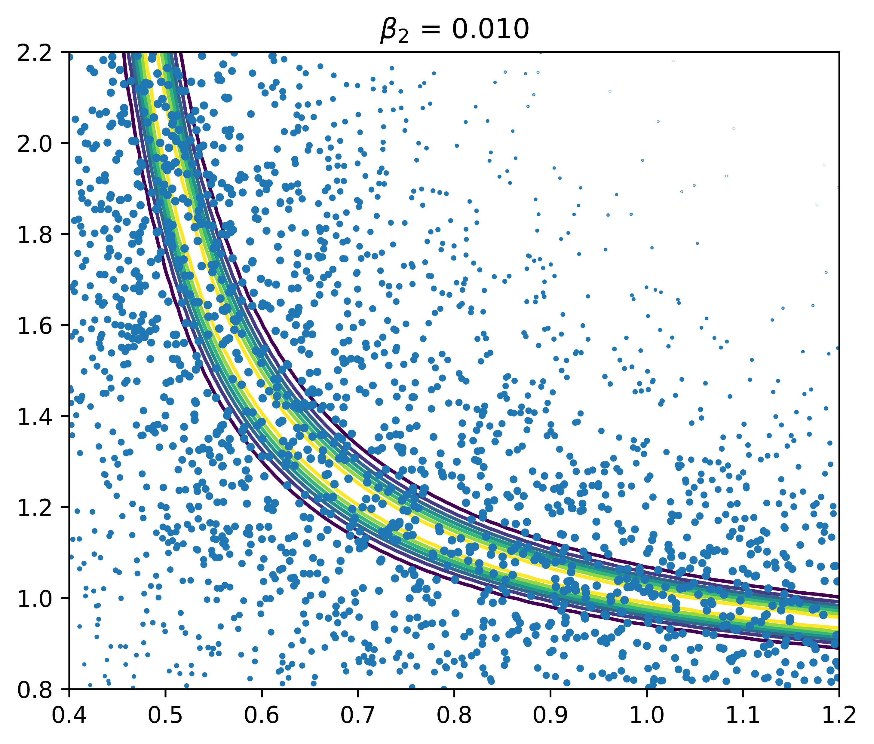
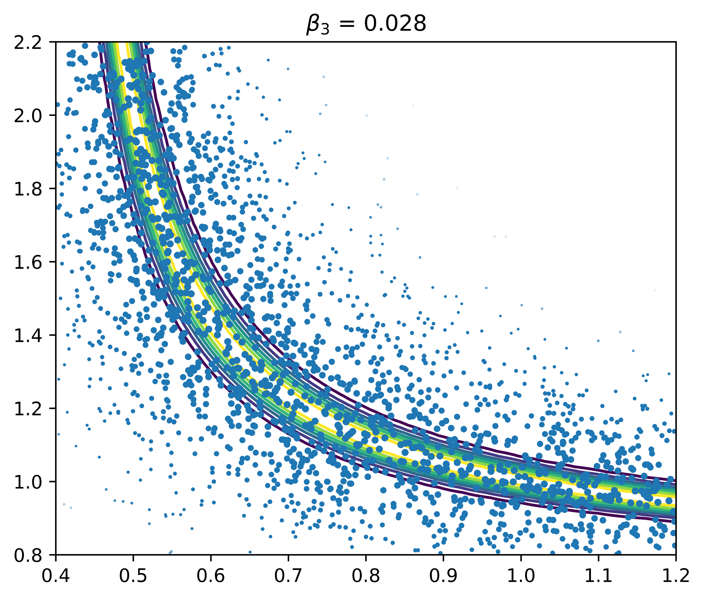
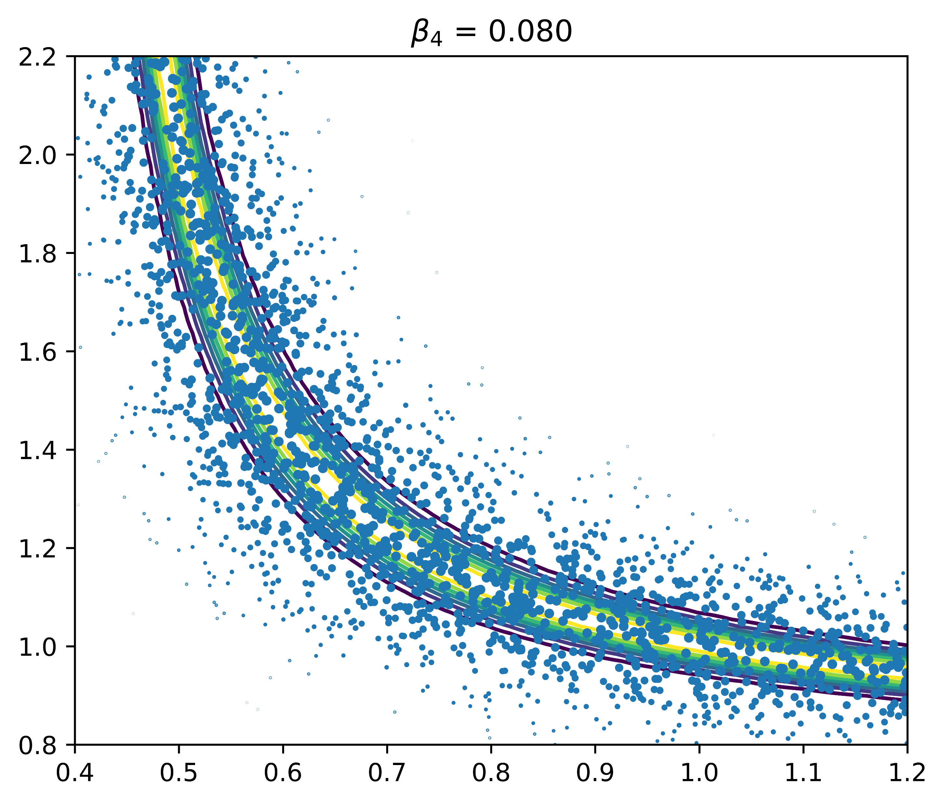
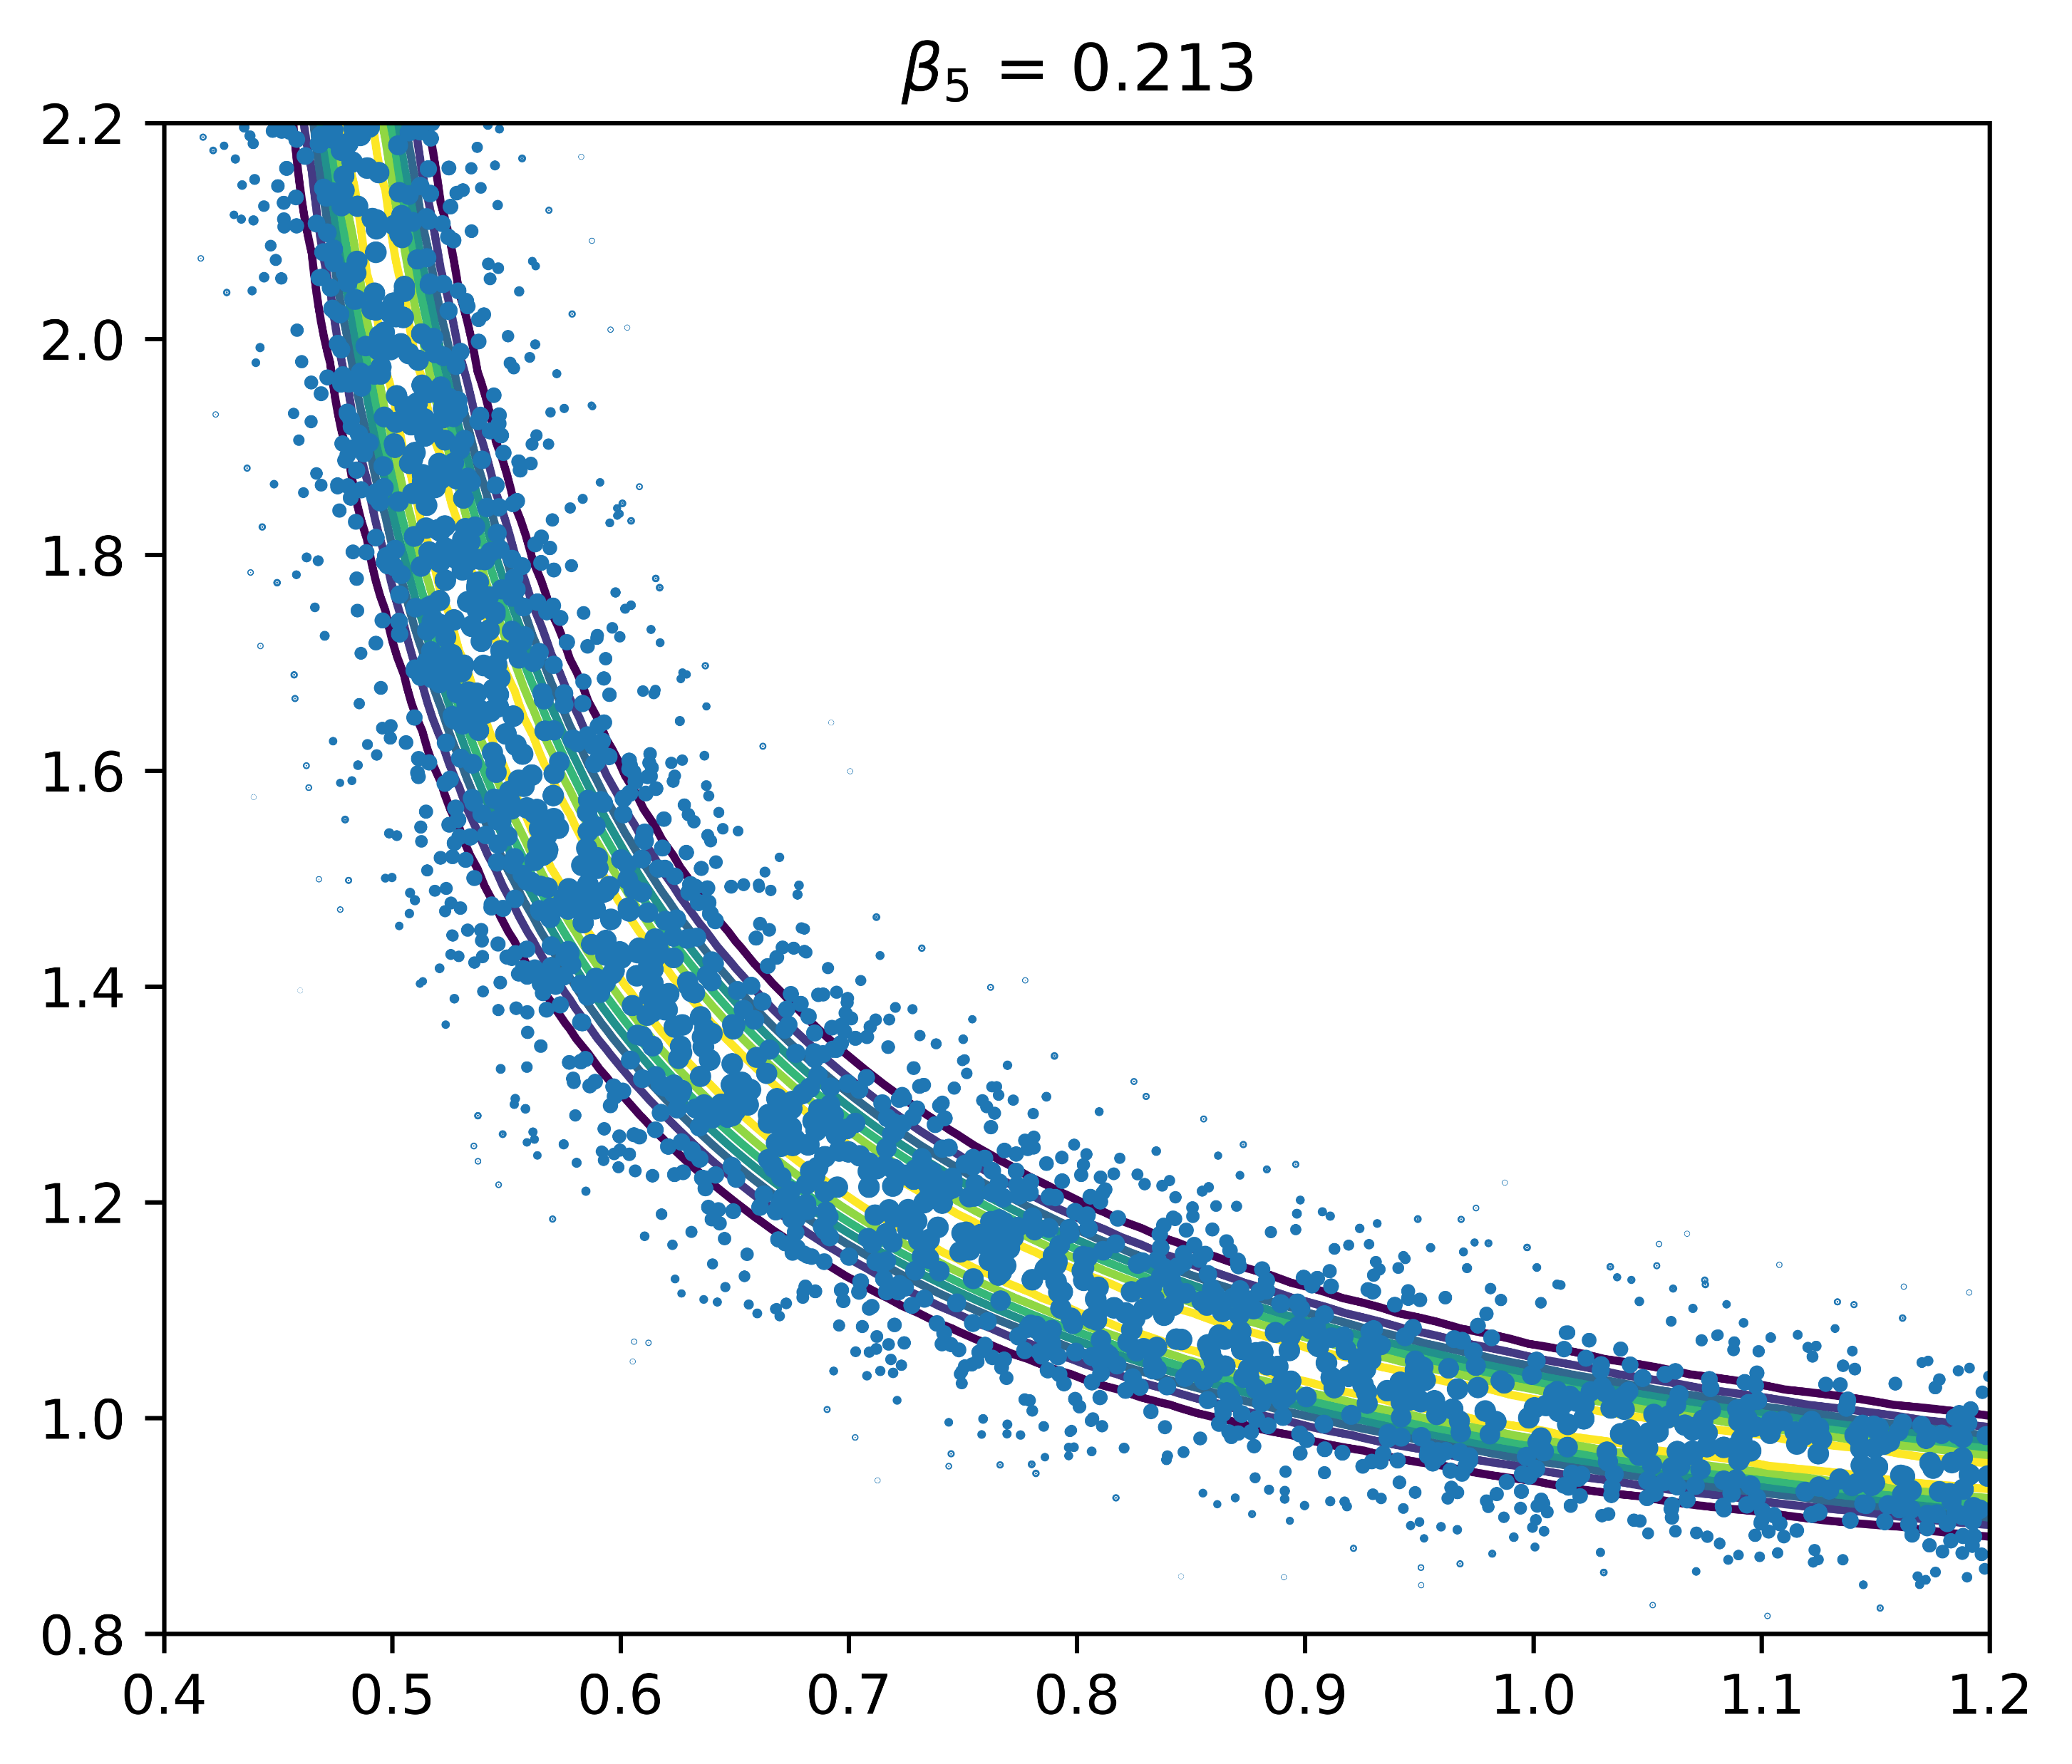

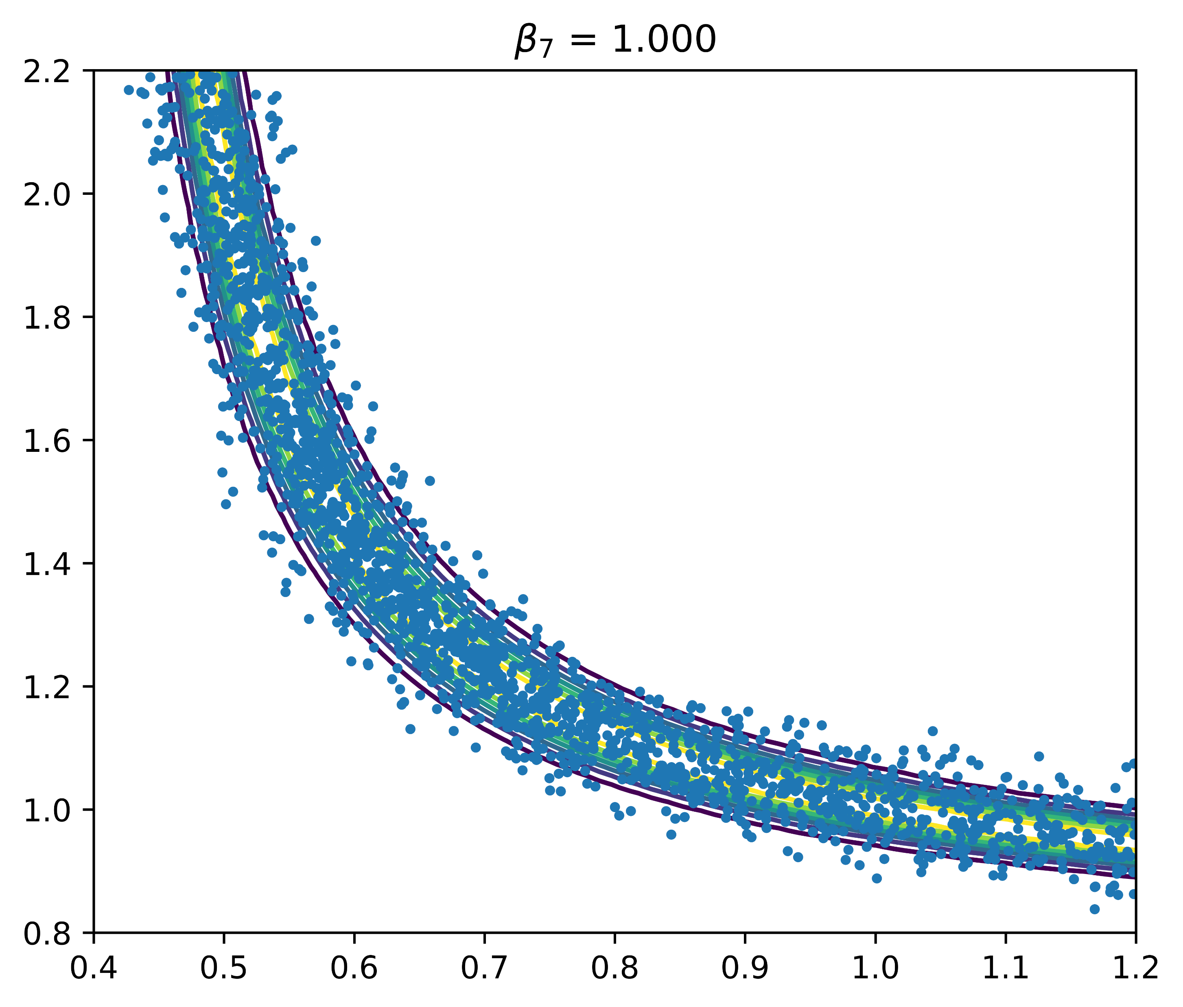
Transitional Markov chain Monte Carlo Illustration
aka Sequential Monte Carlo
2-DOF example for illustration
Parameters: $θ_{1}$ and $θ_{2}$ are unknown
Posterior
Likelihood
Prior
Data: first mode frequency & mode shape
Data: Both modes frequency
Data: only first mode frequency
Notes:
2-DOF examples illustrating the working of the TMCMC algorithm
3 cases
Measured data is first mode frequency & mode shape, red cross is true, contours shows analytical posterior (has only one peak), Initial particles are samples of prior, there particles are moved stage wise in TMCMC algorithm until they represent the samples of the posterior
Measured data is mode 1 and 2 frequency. Posterior is bimodal. TMCMC also captures the bimodal posterior well
Measured data is only mode 1 frequency. Posterior has a flat peak. TMCMC also captures this well.

Slide 2
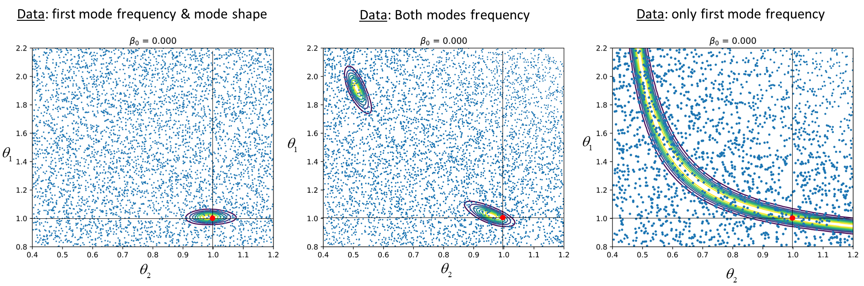
Data: first mode frequency & mode shape
Data: Both modes frequency
Data: only first mode frequency
Notes:
2-DOF examples illustrating the working of the TMCMC algorithm
3 cases
Measured data is first mode frequency & mode shape, red cross is true, contours shows analytical posterior (has only one peak), Initial particles are samples of prior, there particles are moved stage wise in TMCMC algorithm until they represent the samples of the posterior
Measured data is mode 1 and 2 frequency. Posterior is bimodal. TMCMC also captures the bimodal posterior well
Measured data is only mode 1 frequency. Posterior has a flat peak. TMCMC also captures this well.

Slide 3
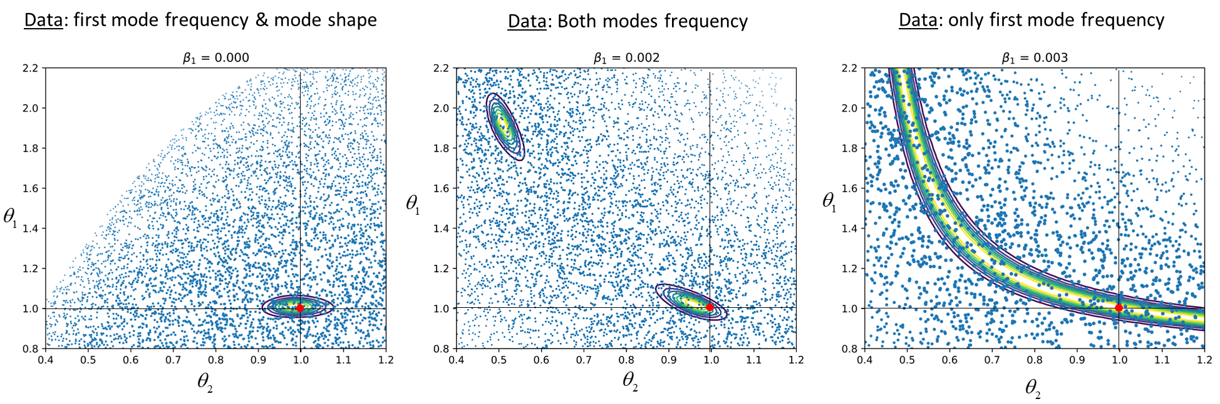
Data: first mode frequency & mode shape
Data: Both modes frequency
Data: only first mode frequency
Notes:
2-DOF examples illustrating the working of the TMCMC algorithm
3 cases
Measured data is first mode frequency & mode shape, red cross is true, contours shows analytical posterior (has only one peak), Initial particles are samples of prior, there particles are moved stage wise in TMCMC algorithm until they represent the samples of the posterior
Measured data is mode 1 and 2 frequency. Posterior is bimodal. TMCMC also captures the bimodal posterior well
Measured data is only mode 1 frequency. Posterior has a flat peak. TMCMC also captures this well.

Slide 4
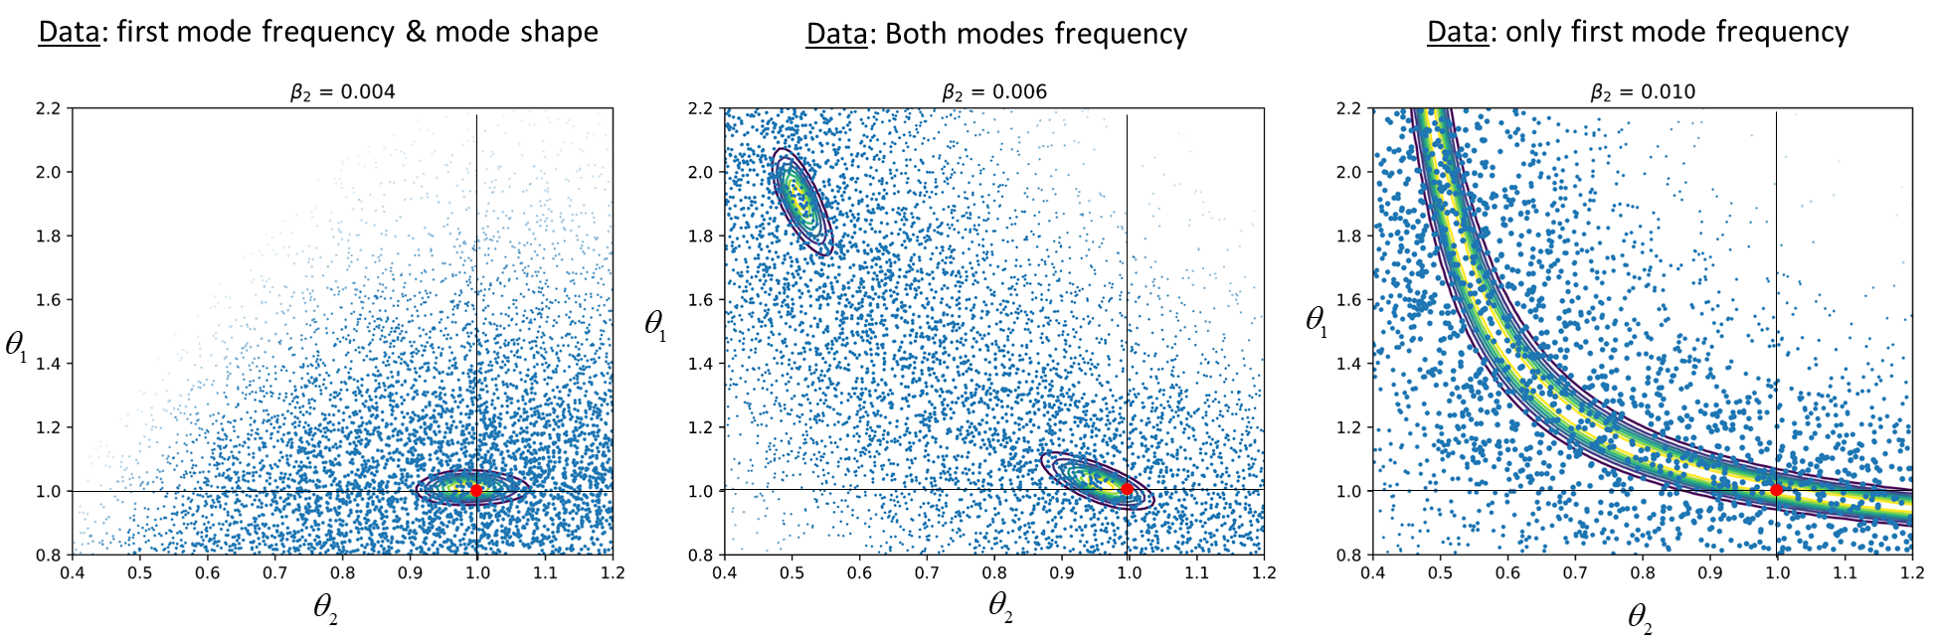
Data: first mode frequency & mode shape
Data: Both modes frequency
Data: only first mode frequency
Notes:
2-DOF examples illustrating the working of the TMCMC algorithm
3 cases
Measured data is first mode frequency & mode shape, red cross is true, contours shows analytical posterior (has only one peak), Initial particles are samples of prior, there particles are moved stage wise in TMCMC algorithm until they represent the samples of the posterior
Measured data is mode 1 and 2 frequency. Posterior is bimodal. TMCMC also captures the bimodal posterior well
Measured data is only mode 1 frequency. Posterior has a flat peak. TMCMC also captures this well.

Slide 5
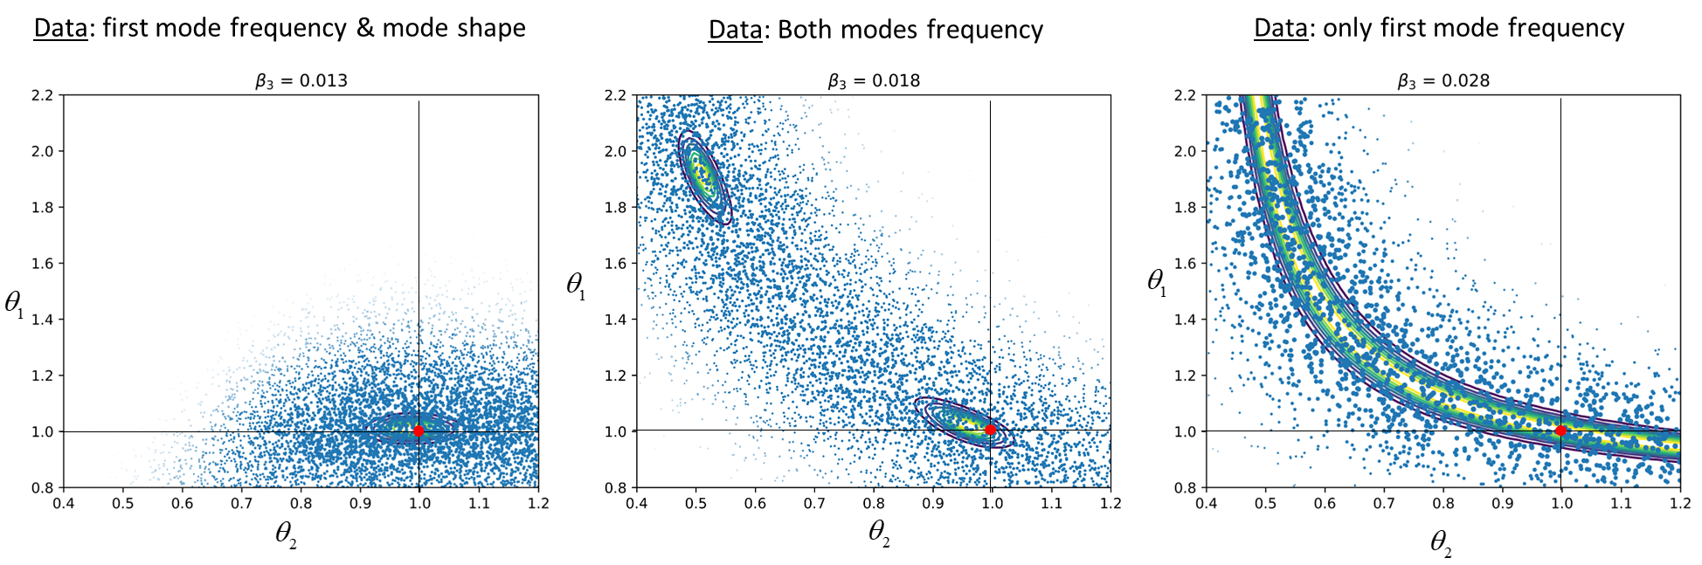
Data: first mode frequency & mode shape
Data: Both modes frequency
Data: only first mode frequency
Notes:
2-DOF examples illustrating the working of the TMCMC algorithm
3 cases
Measured data is first mode frequency & mode shape, red cross is true, contours shows analytical posterior (has only one peak), Initial particles are samples of prior, there particles are moved stage wise in TMCMC algorithm until they represent the samples of the posterior
Measured data is mode 1 and 2 frequency. Posterior is bimodal. TMCMC also captures the bimodal posterior well
Measured data is only mode 1 frequency. Posterior has a flat peak. TMCMC also captures this well.

Slide 6
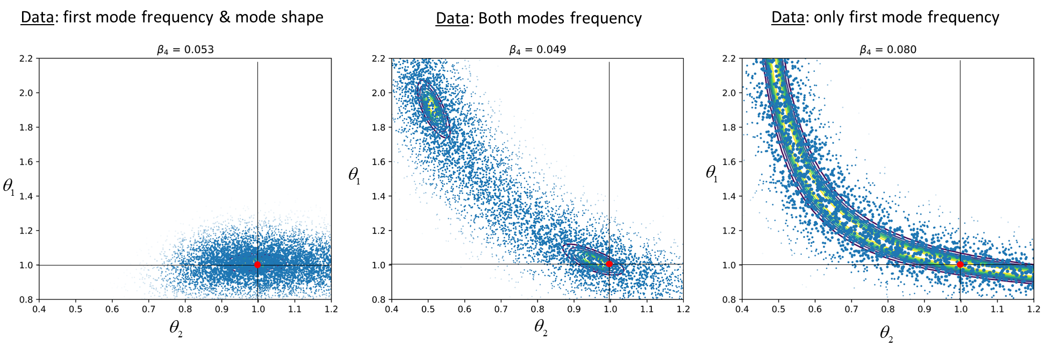
Data: first mode frequency & mode shape
Data: Both modes frequency
Data: only first mode frequency
Notes:
2-DOF examples illustrating the working of the TMCMC algorithm
3 cases
Measured data is first mode frequency & mode shape, red cross is true, contours shows analytical posterior (has only one peak), Initial particles are samples of prior, there particles are moved stage wise in TMCMC algorithm until they represent the samples of the posterior
Measured data is mode 1 and 2 frequency. Posterior is bimodal. TMCMC also captures the bimodal posterior well
Measured data is only mode 1 frequency. Posterior has a flat peak. TMCMC also captures this well.

Slide 7
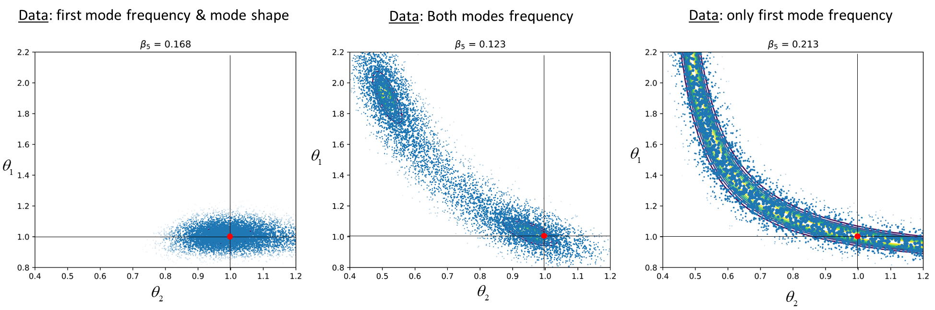
Data: first mode frequency & mode shape
Data: Both modes frequency
Data: only first mode frequency
Notes:
2-DOF examples illustrating the working of the TMCMC algorithm
3 cases
Measured data is first mode frequency & mode shape, red cross is true, contours shows analytical posterior (has only one peak), Initial particles are samples of prior, there particles are moved stage wise in TMCMC algorithm until they represent the samples of the posterior
Measured data is mode 1 and 2 frequency. Posterior is bimodal. TMCMC also captures the bimodal posterior well
Measured data is only mode 1 frequency. Posterior has a flat peak. TMCMC also captures this well.

Slide 8
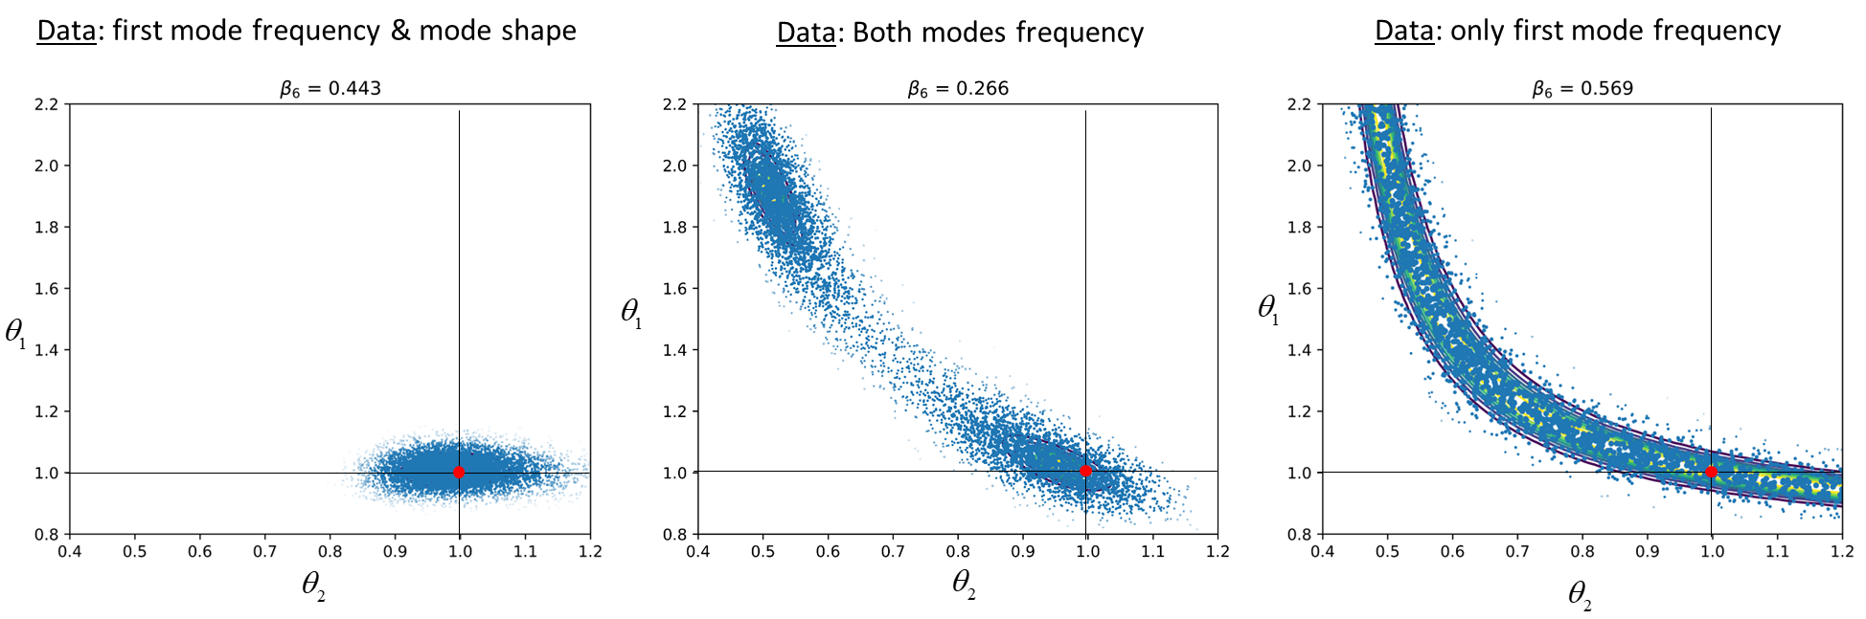
Data: first mode frequency & mode shape
Data: Both modes frequency
Data: only first mode frequency
Notes:
2-DOF examples illustrating the working of the TMCMC algorithm
3 cases
Measured data is first mode frequency & mode shape, red cross is true, contours shows analytical posterior (has only one peak), Initial particles are samples of prior, there particles are moved stage wise in TMCMC algorithm until they represent the samples of the posterior
Measured data is mode 1 and 2 frequency. Posterior is bimodal. TMCMC also captures the bimodal posterior well
Measured data is only mode 1 frequency. Posterior has a flat peak. TMCMC also captures this well.

Slide 9
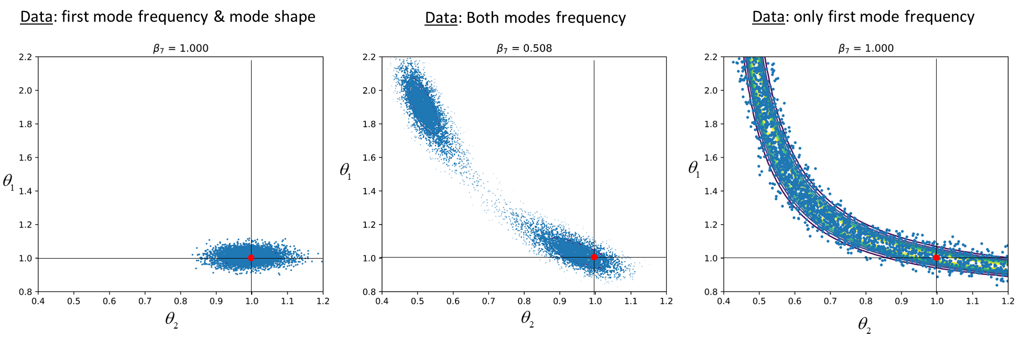
Data: first mode frequency & mode shape
Data: Both modes frequency
Data: only first mode frequency
Notes:
2-DOF examples illustrating the working of the TMCMC algorithm
3 cases
Measured data is first mode frequency & mode shape, red cross is true, contours shows analytical posterior (has only one peak), Initial particles are samples of prior, there particles are moved stage wise in TMCMC algorithm until they represent the samples of the posterior
Measured data is mode 1 and 2 frequency. Posterior is bimodal. TMCMC also captures the bimodal posterior well
Measured data is only mode 1 frequency. Posterior has a flat peak. TMCMC also captures this well.

Slide 10

Data: first mode frequency & mode shape
Data: Both modes frequency
Data: only first mode frequency
Notes:
2-DOF examples illustrating the working of the TMCMC algorithm
3 cases
Measured data is first mode frequency & mode shape, red cross is true, contours shows analytical posterior (has only one peak), Initial particles are samples of prior, there particles are moved stage wise in TMCMC algorithm until they represent the samples of the posterior
Measured data is mode 1 and 2 frequency. Posterior is bimodal. TMCMC also captures the bimodal posterior well
Measured data is only mode 1 frequency. Posterior has a flat peak. TMCMC also captures this well.

Slide 11
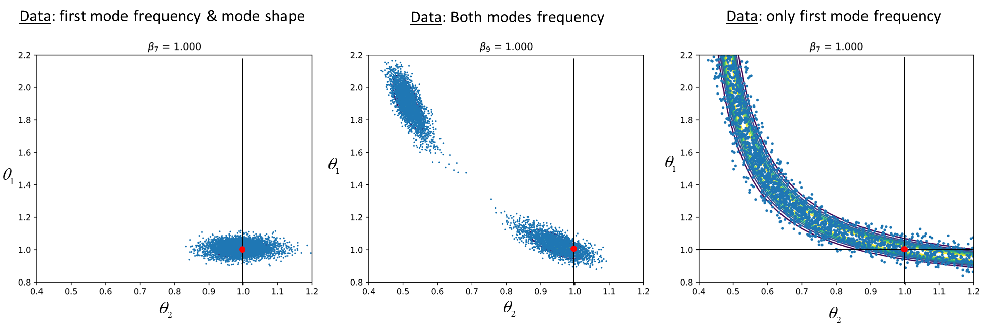
Data: first mode frequency & mode shape
Data: Both modes frequency
Data: only first mode frequency
Notes:
2-DOF examples illustrating the working of the TMCMC algorithm
3 cases
Measured data is first mode frequency & mode shape, red cross is true, contours shows analytical posterior (has only one peak), Initial particles are samples of prior, there particles are moved stage wise in TMCMC algorithm until they represent the samples of the posterior
Measured data is mode 1 and 2 frequency. Posterior is bimodal. TMCMC also captures the bimodal posterior well
Measured data is only mode 1 frequency. Posterior has a flat peak. TMCMC also captures this well.

